Slide 1

Azul Connect

Slide 2
Project Vision
Connect creative individuals with groups that can enact dreams
Allow innovation by promoting the public view of project ideas
Provide an opportunity for the community to engage & improve with applied experience on projects

Slide 3
Problem
Lack of Ideas: Many ideas are never shared, and can never improve the community
Lack of Connections: Many ideas that are present lack widespread advertising, and don’t reach all interested people
Talent & Ability: No one person can accomplish all projects on their own, limiting the scope of ideas
Freedom: The more common University-sponsored projects have relatively rigid requirements, which can prevent creative solutions

Slide 4

Product Overview

Slide 5
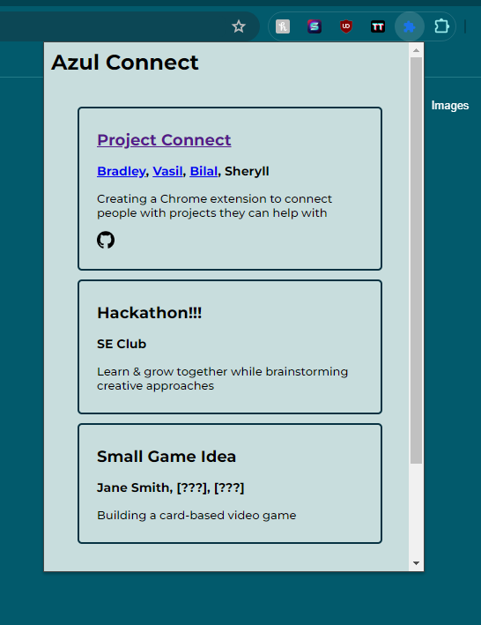
Key Features
Open Forum: All members are encouraged to share their project ideas
Ease-of-Use: Extension has a simple interface with a clean and easy-to-use design
Access to Resources: The main contributors already on the project and links to project resources are present
Messaging: (TBD) Allows prospective project participants to connect with project members before joining

Slide 6
Technologies
HTML/CSS-based extension
Document-style database (e.g. MongoDB)
Linked internal/external platform for communication
That’s all! Lightweight = Easier to implement

Slide 7

Thank you
Brita Tamm
502-555-0152
brita@firstupconsultants.com
www.firstupconsultants.com

Slide 8
SAMPLE SLIDE FORMAT
Unique
First to market
Tested
Authentic
Only product specifically dedicated to this niche market
First beautifully designed product that's both stylish and functional
Conducted testing with college students in the area
Designed with the help and input of experts in the field

Slide 9
SAMPLE SLIDE FORMAT
Our product is priced below that of other companies on the market
Design is simple and easy to use, compared to the complex designs of the competitors
Affordability is the main draw for our consumers to our product
Company A product is more expensive
Companies B & C product is expensive and inconvenient to use
Companies D & E product is affordable, but inconvenient to use

